Slide 1
Lossy Compression Algorithms
Chapter 8
Notes:
115/11/08

Slide 2
Mutimedia Compress
fixed length, variable length, run length, dictionary based
DPCM module
Lookup table
DCT transform
Lossless Compression
Reconstruct
Symbols
bits
bits
Symbols
Quantizer
Encoder
Decoder
Q⁻¹
signal
s
data
stream
binary
stream
binary
stream
data
stream
~
s
Lossy Compression

Slide 3
Mutimedia Compress
fixed length, variable length, run length, dictionary based
DPCM module
Lookup table
DCT transform
Lossless Compression
Reconstruct
Symbols
bits
bits
Symbols
Quantizer
Encoder
Decoder
Q⁻¹
signal
s
data
stream
binary
stream
binary
stream
data
stream
~
s
Transform
coding
Lossy Compression
Midrise/midtread, uniform/nonuniform, vector quantization

Slide 4
outline
8.1 Introduction
8.2 Distortion Measures
8.3 The Rate-Distortion Theory
8.4 Quantization
8.5 Transform Coding
8.6 Wavelet-Based Coding
8.7 Wavelet Packets
8.8 Embedded Zerotree of Wavelet Coefficients
8.9 Set Partitioning in Hierarchical Trees (SPIHT)
8.10 Further Exploration

Slide 5
8.1 Introduction
Lossless compression algorithms
  low compression ratios
  → Most multimedia compression are lossy.
What is lossy compression ?
  Not the same as, but a close approximation to, the original data.
  Much higher compression ratio

Slide 6
8.2 Distortion Measures
Three most commonly used distortion measures in image compression:
  Mean square error
  Signal to noise ratio
  Peak signal to noise ratio

Slide 7



8.2 Distortion Measures
Mean Square Error，MSE
Signal to Noise Ratio, SNR
  where σ_{x}² is the avg square value of original input，andσ_{d}² is the MSE.
Peak Signal to Noise Ratio, PSNR
The lower the better.
The higher the better.
The higher the better.
Notes:
115/11/08

Slide 8
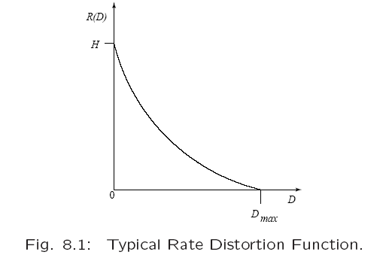
8.3 Rate Distortion Theory
Provides a framework for the study of tradeoffs between (data-)Rate and distortion
H=Entropy,
量化後符號系統之亂度,
等同於lossless 轉 bit 之長度。亂度越高表示 資料越豐富,越不失真,
但壓縮越差
H=0 … #sym =1
H=1 … #sym =2¹
H=2 … #sym =2²
[hint]
Quantization
無限多級 v.s. 0級
H=0
最高壓縮 (mean for all)
最不正確
D_{max} =Variance,
(MSE) (mean for all)

Slide 9
outline
8.1 Introduction
8.2 Distortion Measures
8.3 The Rate-Distortion Theory
8.4 Quantization
8.5 Transform Coding
8.6 Wavelet-Based Coding
8.7 Wavelet Packets
8.8 Embedded Zerotree of Wavelet Coefficients
8.9 Set Partitioning in Hierarchical Trees (SPIHT)
8.10 Further Exploration

Slide 10
Mutimedia Compress
fixed length, variable length, run length, dictionary based
DPCM module
Lookup table
DCT transform
Lossless Compression
Reconstruct
Symbols
bits
bits
Symbols
Quantizer
Encoder
Decoder
Q⁻¹
signal
s
data
stream
binary
stream
binary
stream
data
stream
~
s
Transform
coding
Lossy Compression
Midrise/midtread, uniform/nonuniform, vector quantization

Slide 11
8.4 Quantization
Reduce the number of distinct output values
  To a much smaller set.
Main source of the “loss" in lossy compression.
  Lossy Compression: 以"量化失真"換取壓縮率
  Lossless Compression: 以量化後的"符號"進行無失真編碼
Three different forms of quantization.
  Uniform: midrise and midtread quantizers.
  Nonuniform: companded quantizer.
  Vector Quantization (→ 8.5 Transform Coding)
Lossy Compression =
Quantization + Lossless Compression

Slide 12


Two types of uniform scalar quantizers:
Midrise quantizers have even number of output levels.
Midtread quantizers have odd number of output levels, including zero as one of them (see Fig. 8.2).
For the special case where the “step size” Δ =1
Boundaries B={ b₀, b₁,...,b_{M}},
Output Y ={y₁, y₂,…, y_{M}}
The (bit) rate of the quantizer is

Slide 13
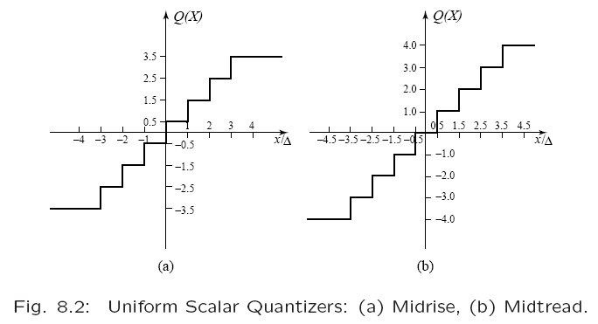
Even levels
Odd levels

Slide 14

Non-uniform (Companded) Quantizer
compender
expander
Recall: m-law and A-law Companders

Slide 15
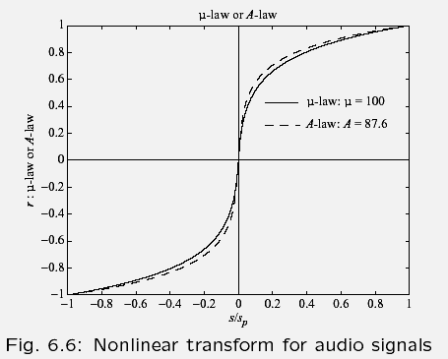
Nonlinear Transform for audio signals
Fig 6.6
r
s/s_{p}

Slide 16
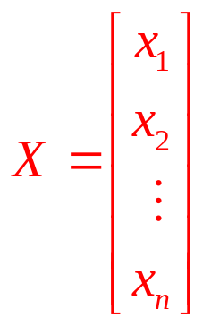
Vector Quantization (VQ)
Compression on “vectors of samples”
  Vector Quantization
  Transform Coding (Sec 8.5)
Consecutive samples form a single vector.
  A Segment of a speech sample
  A group of consecutive pixels in an image
  A chunk of data in any format
Other example: the GIF image format
  Lookup Table (aka: Palette/ Color map…)
  → Quantization (lossy) → LZW (lossless)

Slide 17
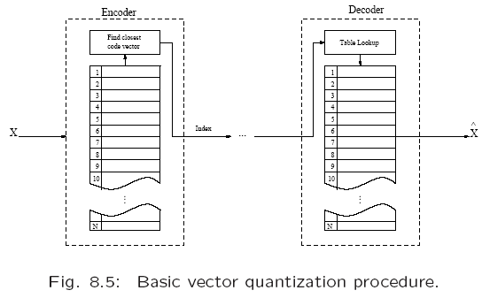
(5, 8, 3)
(5, 7, 3)
(5, 7, 2)
"9"
(5, 8, 2)
(5, 8, 2)

Slide 18
outline
8.1 Introduction
8.2 Distortion Measures
8.3 The Rate-Distortion Theory
8.4 Quantization
8.5 Transform Coding
8.6 Wavelet-Based Coding
8.7 Wavelet Packets
8.8 Embedded Zerotree of Wavelet Coefficients
8.9 Set Partitioning in Hierarchical Trees (SPIHT)
8.10 Further Exploration

Slide 19
Mutimedia Compress
fixed length, variable length, run length, dictionary based
DPCM module
Lookup table
DCT transform
Lossless Compression
Reconstruct
Symbols
bits
bits
Symbols
Quantizer
Encoder
Decoder
Q⁻¹
signal
s
data
stream
binary
stream
binary
stream
data
stream
~
s
Transform
coding
Lossy Compression
Midrise/midtread, uniform/nonuniform, vector quantization

Slide 20
8.5 Transform Coding The rationale behind
X = [ x₁, x₂,…x_{n} ]^{T} be a vector of samples
  Image, piece of music, audio/video clip, text
  Correlation is inherent among neighboring samples.
Transform Coding vs. Vector Quantization
  不再對應X到單個代表值(VQ) ,
  而是轉為Y = T{X} 再對各元素以不同標準量化

Slide 21
8.5 Transform Coding The rationale behind
X = [ x₁, x₂,…x_{n} ]^{T} be a vector of samples
Y= T{ X }
  Components of Y are much less correlated
  Most information is accurately described by the first few components of a transformed vector.
  Y is a linear transform of X (why?)
DFT, DCT, KLT, …
加性(additive): 令 X₃ = X₁+X₂
齊性(homogeneity): 令 X₄ = aX₁
Linear Transform: T{aX₁+bX₂}=aT{X₁}+bT{X₂}=aY₁+bY₂

Slide 22
APPENDIX
Discrete Cosine Transform (DCT)
DCT v.s. DFT
2D – DFT an DCT

Slide 23
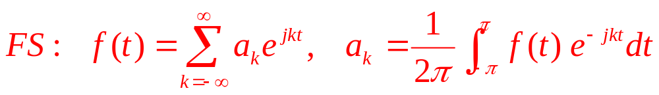
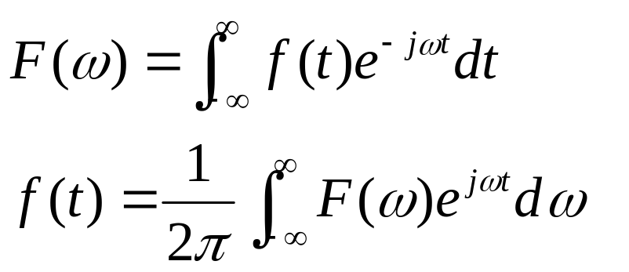
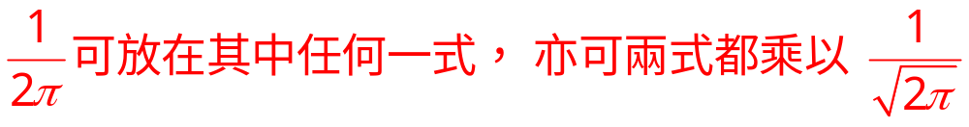
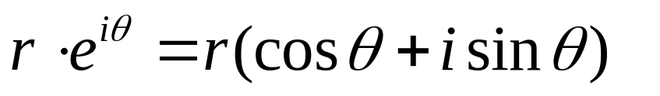
Fourier Transform
F(u₀): 用f(t)訊號來合u₀基頻波
e^{-j2πut} (t為駐點)得F(u₀)
f(t₀): 用F(u)乘以t₀位置各基頻
之值，加總還原出f(t₀)
把係數抽出來，不必
執著於等式的展開，
可以正/逆轉換即可。

Slide 24

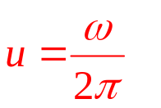
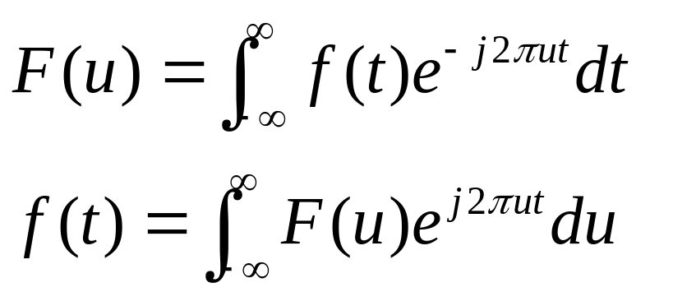
Fourier Transform (Hz)
w: 每秒相角轉幾弧度？
u: 每秒振動幾次(轉幾圈)？

Slide 25
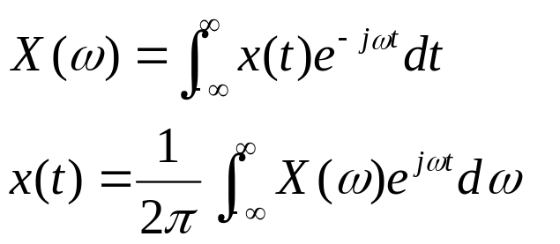
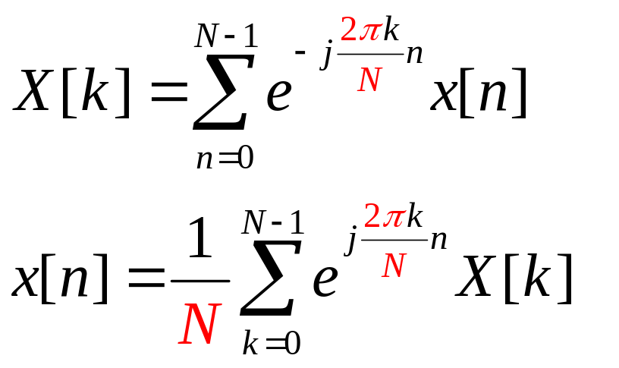
Discrete Fourier Transform (DFT)
讓一個完整週期貼合
數列的完整長度,
w, t 都縮到自己的長度內
N 的意義是長度也是 2 

Slide 26
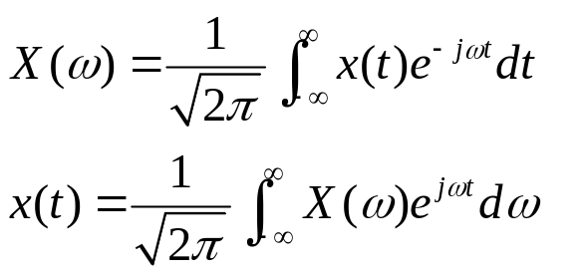
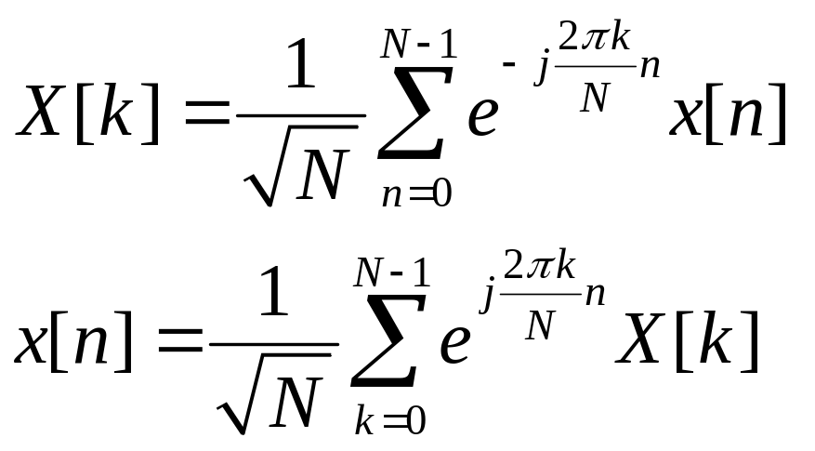
DFT (2)

Slide 27
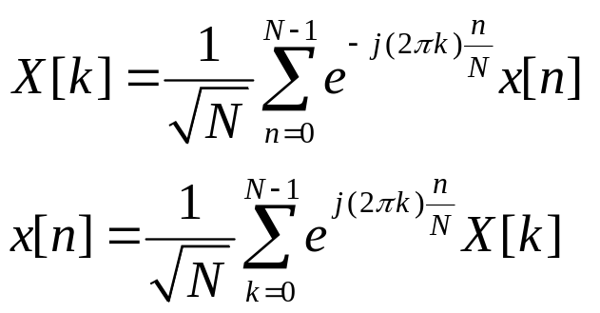
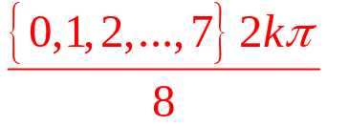
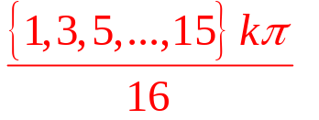
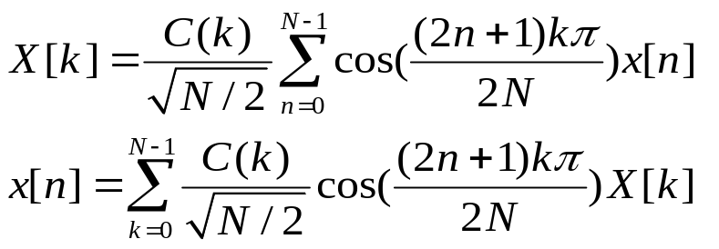
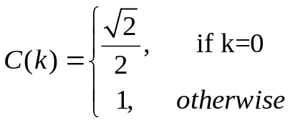
Discrete Cosine Transform (DCT)
DFT:
依頻訊號強度
DCT:

Slide 28
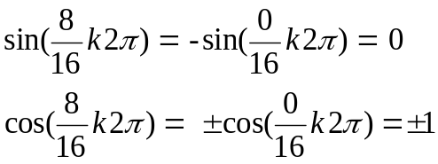


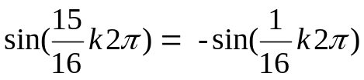
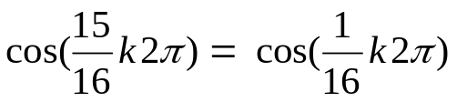
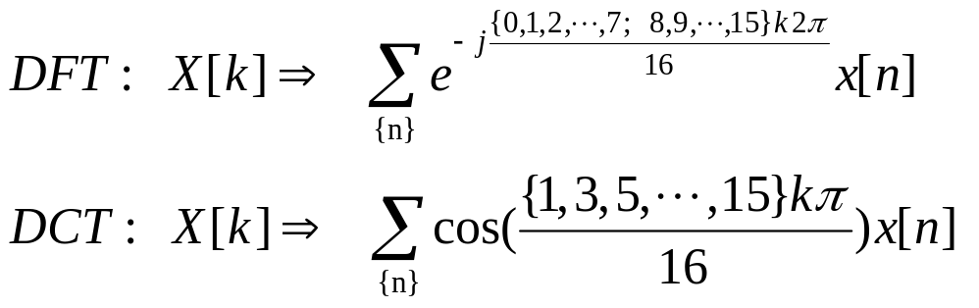
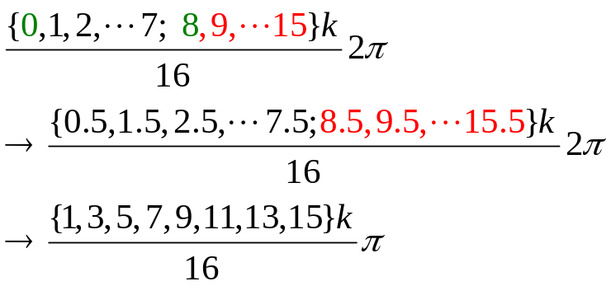
DCT 可以擴增雙倍精度
但要平移半格，造成相銷配對
{0, 1,2,3,4,5,6,7; 8, 9,10,11,12,13,14,15}
0與8 無法
處理，於是要平移半格
虛部抵銷，
實部只須
留下一半，
而其值為
原來兩倍；
DCT →
正逆轉換皆
差半格配對
Notes:
115/11/08

Slide 29
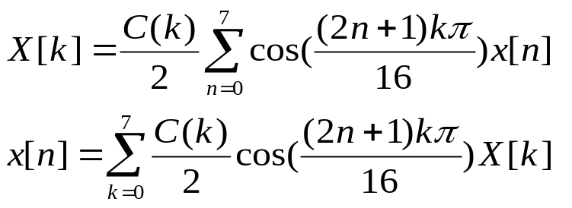
Example of DCT
DCT:
因為“半格的抽樣位移”，取C(0)=0.707，可使正逆轉換中的參與度為 ½，符合正交矩陣的定義。
(N=8)

Slide 30
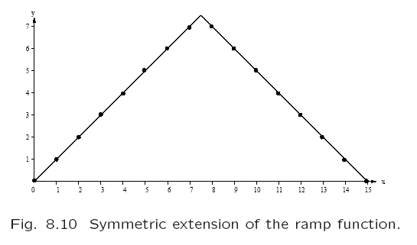
Examination (Ramp Func.)
Notes:
115/11/08

Slide 31
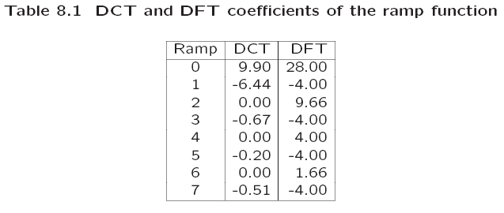
DCT and DFT for a ramp func.
下面的表格與繪圖顯示在一個坡形函數(ramp function)上的DCT與DFT的比較（如果只有使用前三項)：
Notes:
115/11/08

Slide 32
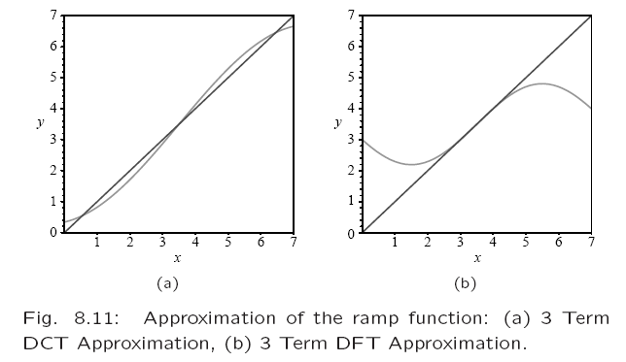
Reconstructing a ramp func.
Notes:
115/11/08

Slide 33
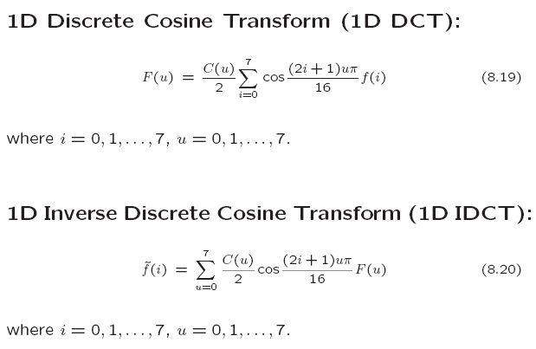
Textbook Contents
i for time-domain index
u for each frequency component
Notes:
115/11/08

Slide 34
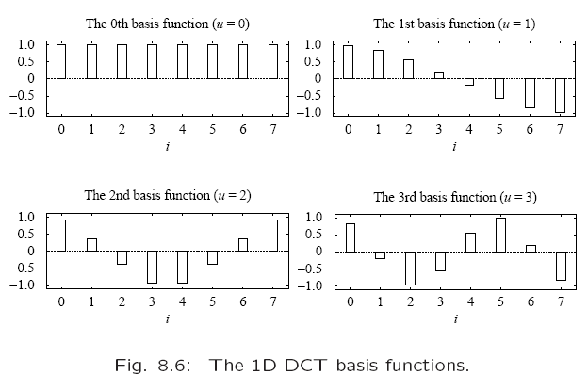
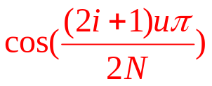
把 Σ_{u} 打開 (N=8)，針對各 u 成份
逐點看f(i)之值，附帶串成波形
反轉換組合時，由 F(u) 調整權值
i for time-domain index
u for each frequency component
1. DC & AC; 2. Basis Functions
cos((π/16) 1)
cos((π/16)15)
i
cos((2π/16) 1)
cos((2π/16)15)
Notes:
115/11/08

Slide 35
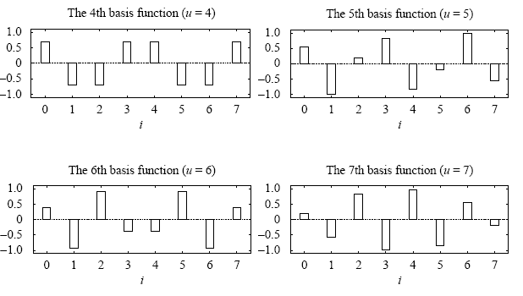
Basis Functions (cont.)
Notes:
115/11/08

Slide 36
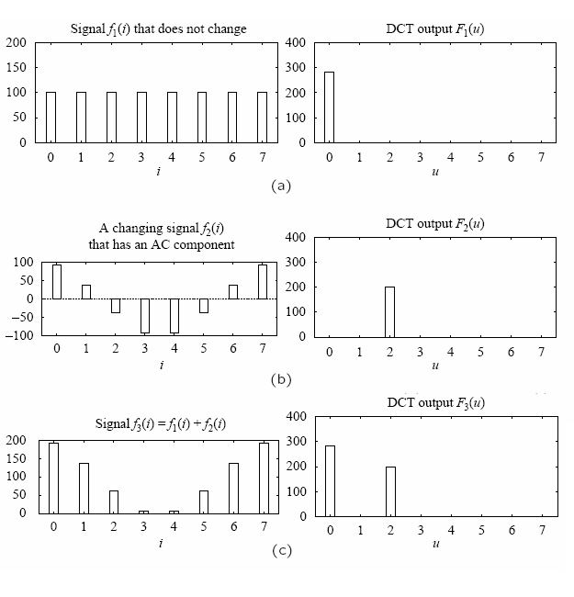
Reconstructing AC Spectrums
+
||
Notes:
115/11/08

Slide 37
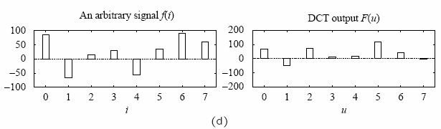
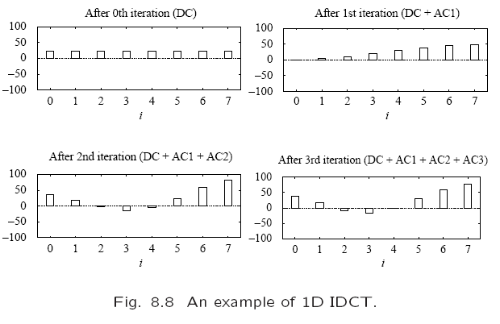
Notes:
115/11/08

Slide 38
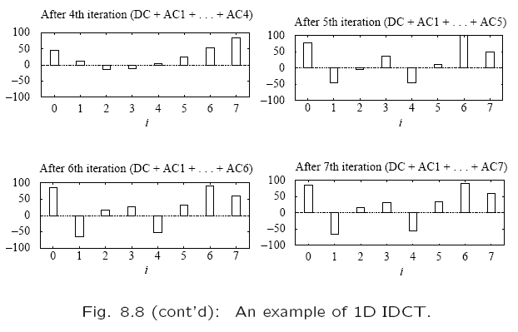
Notes:
115/11/08

Slide 39
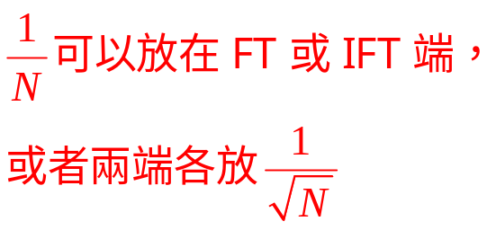
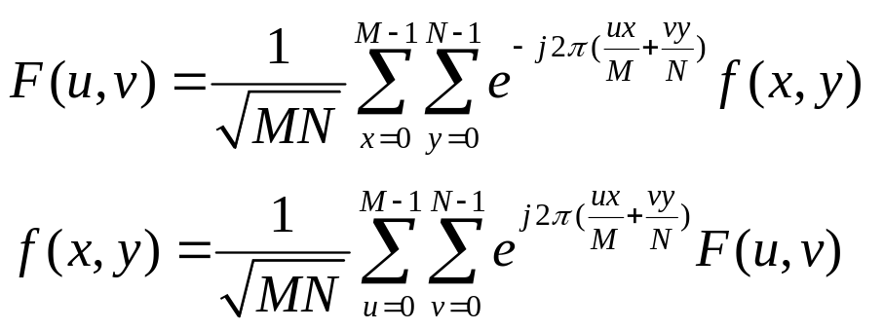
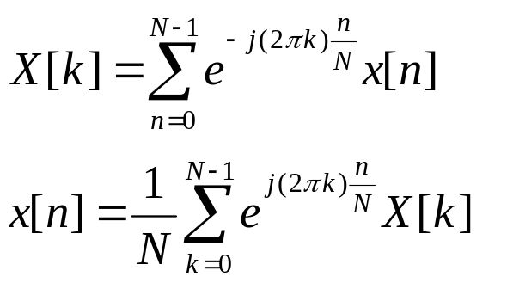
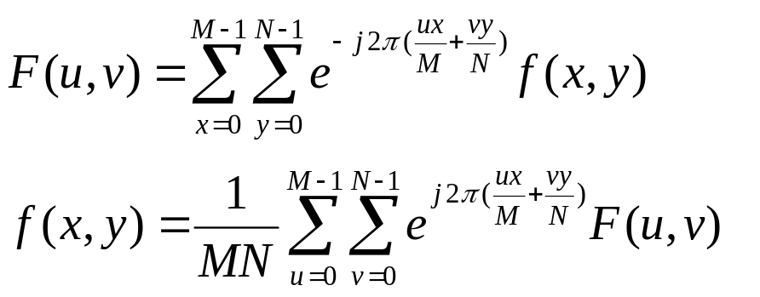
2D - DFT

Slide 40
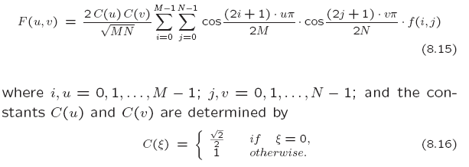
2D - DCT
Notes:
115/11/08

Slide 41
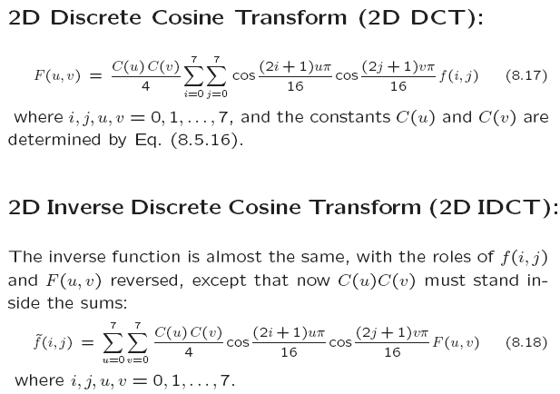
M=N=8
Notes:
115/11/08

Slide 42
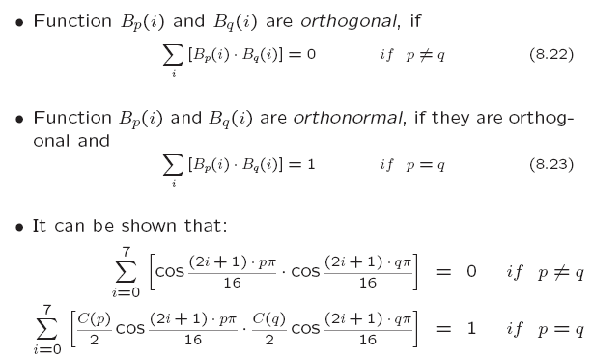
Basis Functions (2D-DCT)
把 Σ_{u,v} 打開 (M=N=8)，針對各 u, v 成份
逐點看f(i,j)之值，附帶串成二維波形
反轉換組合時，由 F(u,v) 調整權值
Notes:
115/11/08

Slide 43
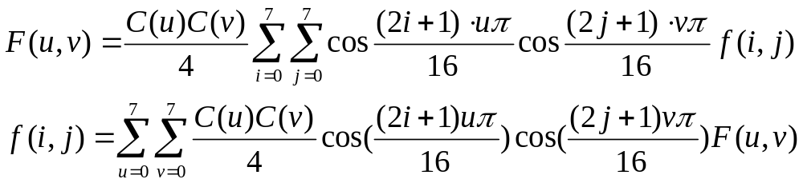
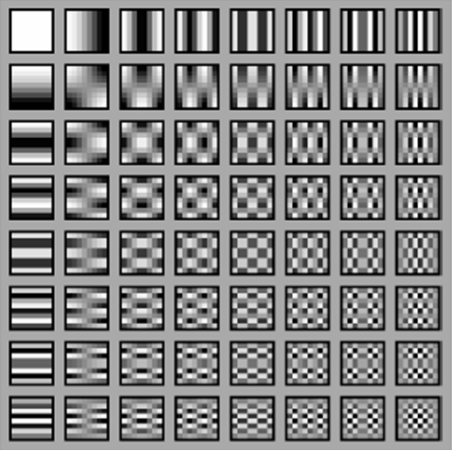
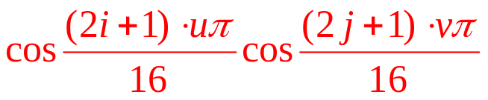
M=N=8 的64 個基頻圖形
1. 使用坐標表示法
2. F總計算量 8x8x8x8
(u,v)=(1,0)
(3,2)
Notes:
115/11/08

Slide 44
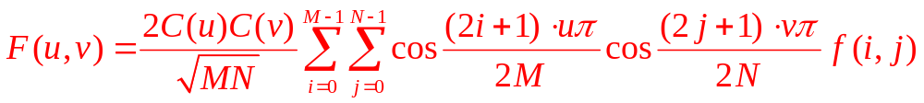
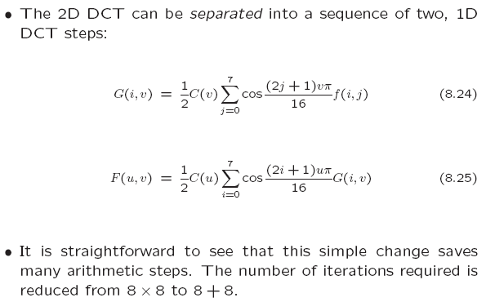
2D Separable Basis
M=N=8
Notes:
115/11/08

Slide 45
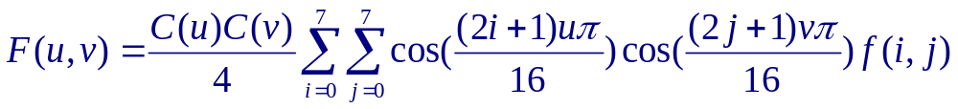





全部F(u,v)總計算量由 8x8x8x8 變成 8x8x8+8x8x8
固定 i 之後, 簡化為 1-D DCT
計算寫回原處, j → v, f(i,j) →G(i,v)
i→ u, G(i,v)→F(u,v)
8x8x8
8x8x8
i=0..7
v=0..7
f(i,j)
G(i,v)
F(u,v)
e.g. i=1, 求 G( i=1 ,v=0..7)
e.g. v=2, 求 F(u=0..7 ,v=2)
e.g. i=1, v=2
e.g. u=3 , v=2

